Slide 1

Fundamental of Cloud Computing
Walter Williams

Slide 2



Agenda
Virtual Machine Instances
Virtual Private Cloud
Azure Virtual Machine Security
Cloud Storage
Cloud Monitoring

Slide 3
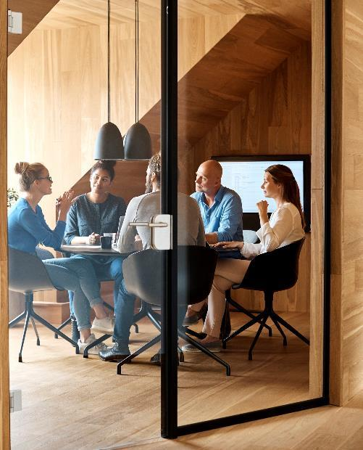



Challenges
Some of the challenges I faced in this course were:
  Understanding and creating subnets
  Utilizing access tiers
  Properly setting up action groups

Slide 4
Introduction
This course gave me the opportunity to develop a working knowledge of virtual machines beginning with their implementation, and continuing with isolating sections of Azure cloud, launching resources with security and storage, while also monitoring the product.

Slide 5

Virtual Machine Instances
Part 1

Slide 6
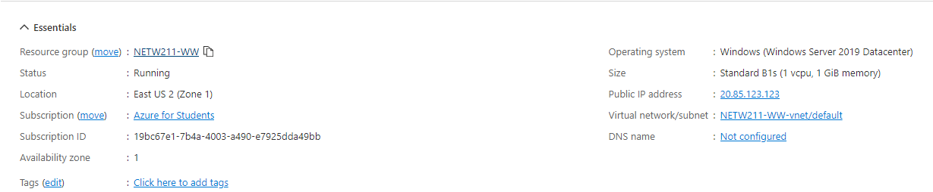
Deploying a VM in Azure

Slide 7
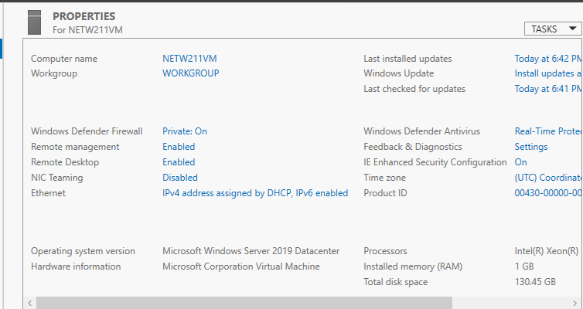
Connecting to the VM

Slide 8
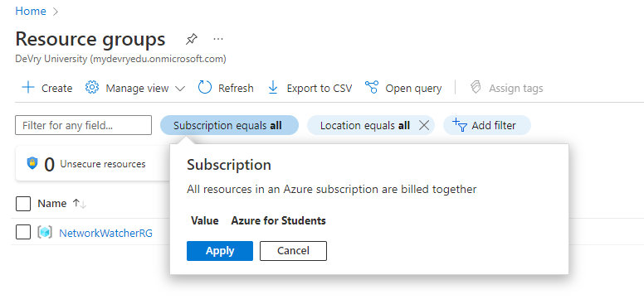
Deleting
the VM

Slide 9
Virtual Private Cloud
Part 2

Slide 10
Creating a VNet with Two Subnets
1. With a /24 network prefix, how many usable IPv4 host addresses are there? [hint: you learned this in NETW191]
Answer here:
2^8 – 2 = 256 – 2 = 254
2. Given the answer above, why is the number of available IP addresses for Subnet0 (10.0.0.0/24) or Subnet1 (10.0.1.0/24) shown as 251? [hint: where did the missing addresses go?]
Answer here:
10.0.X.0 : Network address
192.168.1.1 : Reserved by Azure for the default gateway
192.168.1.2, 192.168.1.3: Reserved by Azure to may the Azure DNS Ips to the Vnet space
192.168.1.255 : Network broadcast address.
References (here are two examples to get your research started):
1. IP Subnet Calculator, https://www.calculator.net/ip-subnet-calculator.html
2. Azure Virtual Network frequently asked questions, https://docs.microsoft.com/en-us/azure/virtual-network/virtual-networks-faq

Slide 11
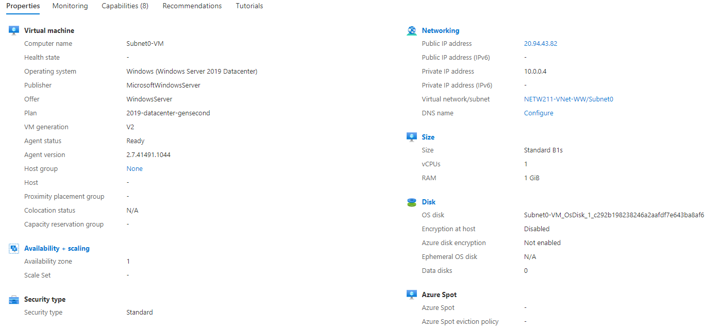
Deploying VMs into Subnets

Slide 12
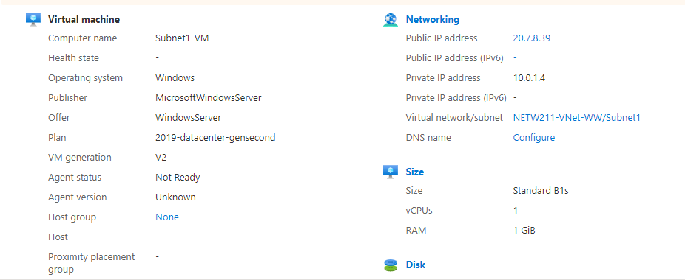
Deploying VMs into Subnets cont’d

Slide 13
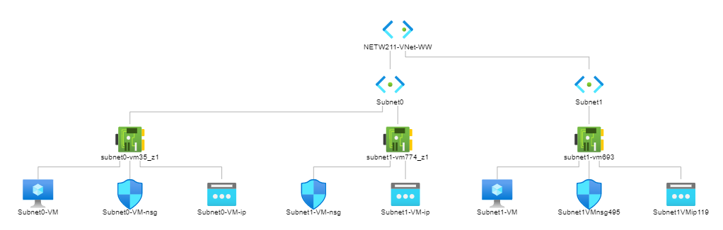
Deploying VMs into Subnets cont’d

Slide 14
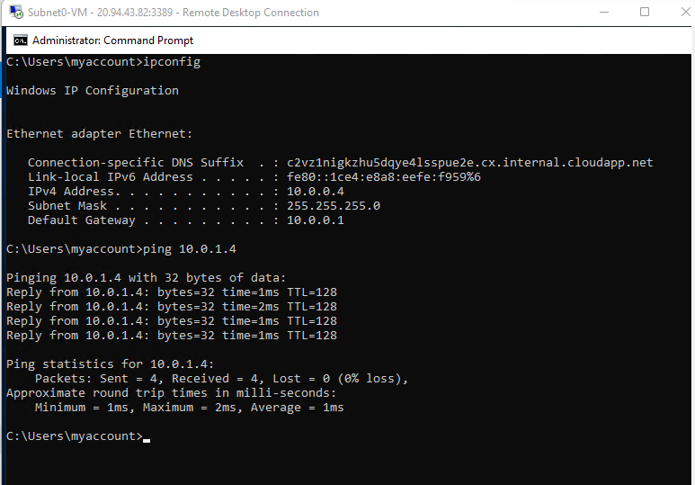
Verifying Connectivity between VMs

Slide 15
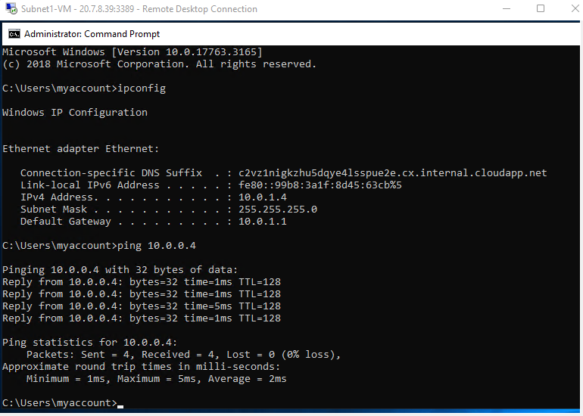
Verifying Connectivity between VMs
cont’d

Slide 16
Azure
Virtual Machine
Security
Part 3

Slide 17
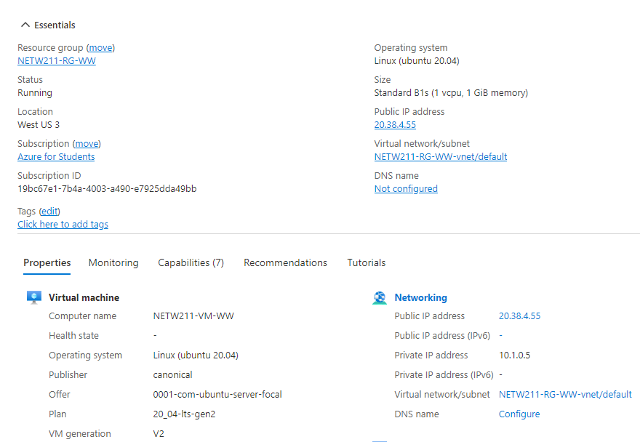
Launching a VM
This screenshot displays the NETW211-VM-My Initials page, with information such as the resource group name, subscription, public IP address, etc.

Slide 18
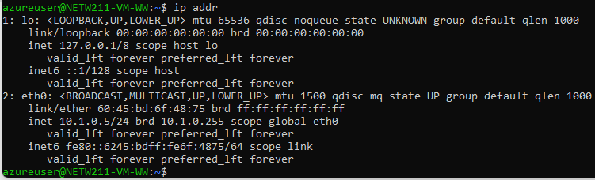
Connecting to the VM via SSH
This screenshot displays the azureuser@NETW211-VM-Your Initials window showing the IPv4 address of the VM in the Azure cloud.

Slide 19
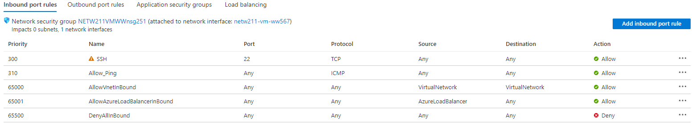
Configuring an NSG
This screenshot displays the Inbound port rules section with the newly added Allow Ping rule.

Slide 20
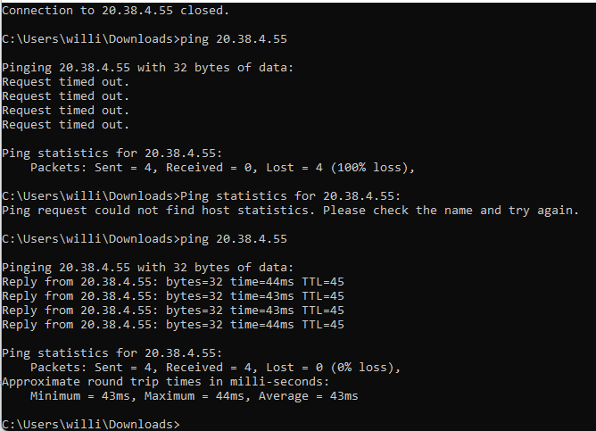
Configuring an NSG
cont’d
This screenshot displays the successful ping result from my local computer to the VM in the Azure cloud.

Slide 21
Cloud Storage
Part 5

Slide 22
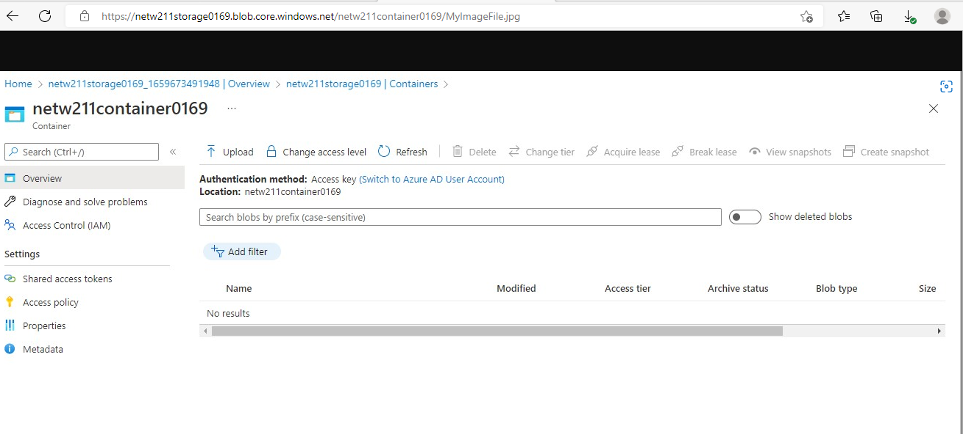
Uploading and Accessing a File
This screenshot displays the browser window with the image uploaded from my local computer and the URL on top of the window.

Slide 23
Question
What does the access tier setting do? What are the Azure blob storage access tiers?
[hint: in the Azure portal, on the Upload blob page, under Advanced, click the ? circle above the Access tier box.]
Answer here:
Hot tier - An online tier optimized for storing data that is accessed or modified frequently. The Hot tier has the highest storage costs, but the lowest access costs.
Cool tier - An online tier optimized for storing data that is infrequently accessed or modified. Data in the Cool tier should be stored for a minimum of 30 days. The Cool tier has lower storage costs and higher access costs compared to the Hot tier.
Archive tier - An offline tier optimized for storing data that is rarely accessed, and that has flexible latency requirements, on the order of hours. Data in the Archive tier should be stored for a minimum of 180 days.
References (here are two examples to get your research started):
1. Hot, Cool, and Archive access tiers for blob data, https://docs.microsoft.com/en-us/azure/storage/blobs/access-tiers-overview
2. Azure Blob Storage Access Tiers, https://devry.percipio.com/courses/c7ef0333-8560-403f-a004-9c5c843866b0/videos/2658bbe6-ee97-438b-a376-fbb079c3b3a0

Slide 24
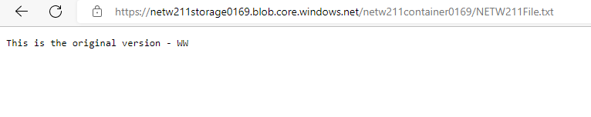
Creating Blob Snapshots
This screenshot displays the browser window with the “This is the original version, with my Initials” message and the URL on top of the window

Slide 25
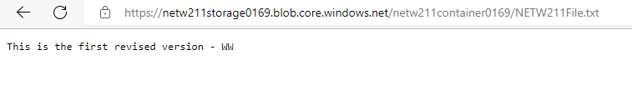
Enabling Blob Versioning
This screenshot displays the browser window with the “This is the first revised version with my Initials” message and the URL on top of the window.

Slide 26
Cloud Monitoring
Part 6

Slide 27
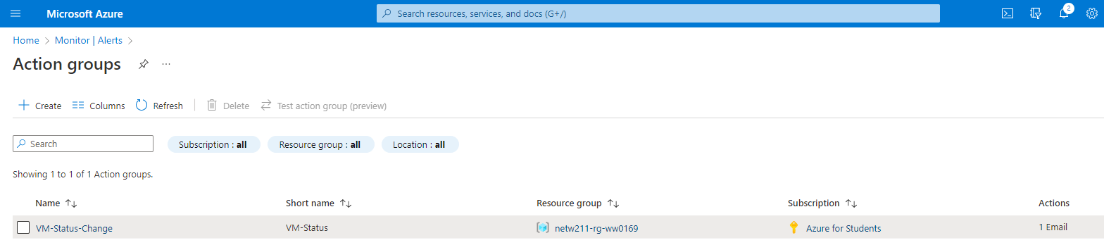
Setting up an Action Group and Notifications
This screenshot should show the “VM-Status-Change” action group on the Manage actions page.

Slide 28
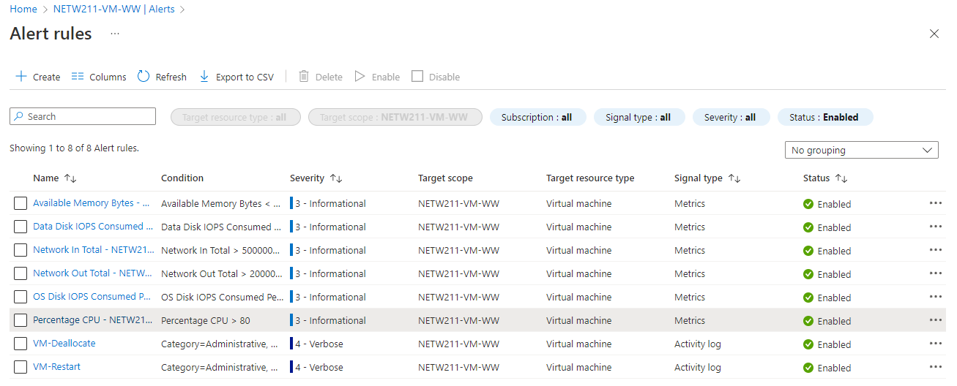
Setting up Alert Rules
This screenshot displays the Alert rules window showing the VM-Deallocate and VM-Restart rules.

Slide 29
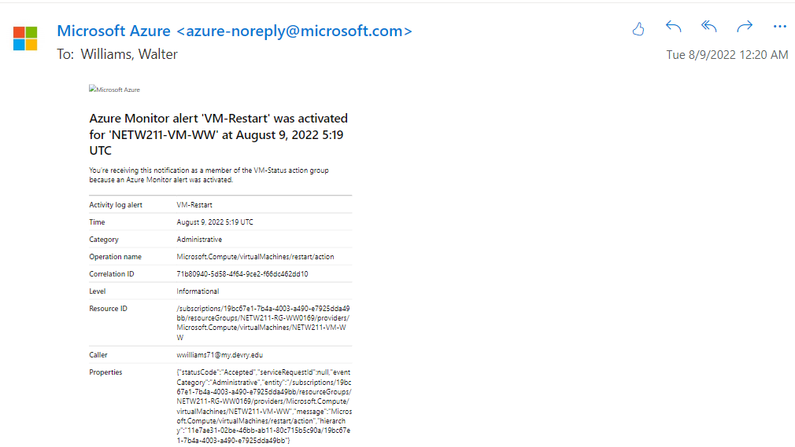
Testing Alerts
This screenshot displays the ‘VM-Restart’ was activated email message with the date and time of the alert.

Slide 30
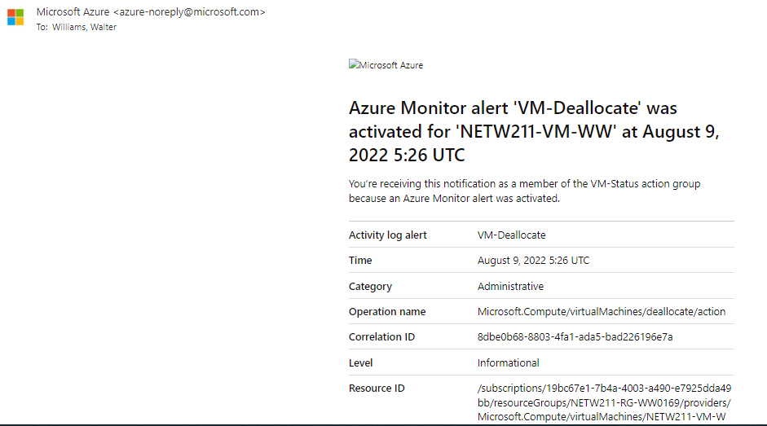
Testing Alerts cont’d
This screenshot displays the ‘VM-Deallocate’ was activated email message with the date and time of the alert.

Slide 31

The way to get started is to quit talking and begin doing.
Walt Disney

Slide 32

Summary
I was able to gain a working knowledge of cloud computing by completing challenges with Virtual Machine Instances, Virtual Private Cloud, Azure Virtual Machine Security, Cloud Storage and Cloud Monitoring.

Slide 33
References
Live/recorded class sections
Lesson modules
IPRO TV
Web

Slide 34


Thank You
Walter Williams
wwilliams71@my.devry.edu
williamswalter67.wixsite.com

